Slide 1

RESEARCH CENTRE IMARAT
DIRECTORATE OF EMBEDDED AND ARTIFICIAL INTELLIGENCE SYSTEMS
Project presentation
on
UAV Swarm Formation & Path Planning
RCI Guide: Archana Ma’am & Sai Charan Sir Anup Kumar Tiwari →College Guide: Dr. Soumya S.
Akshaan Gupta →College Guide: Dr. MM Kuber Asuwin.J →College Guide: Dr. MM Kuber

Slide 2
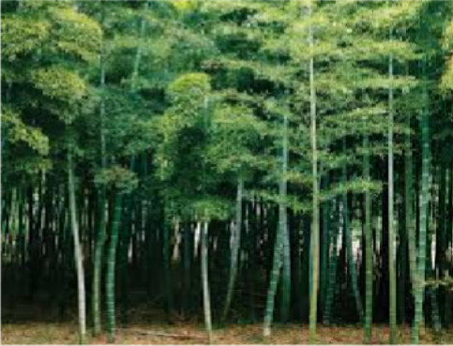
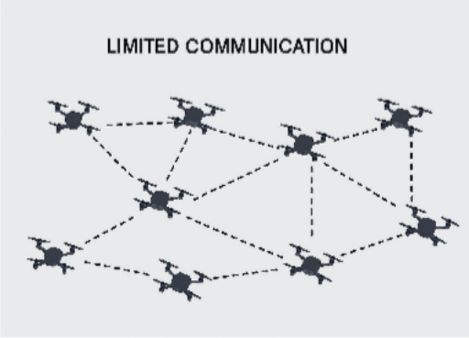
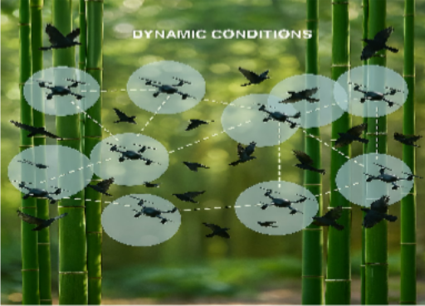
Problem Statement
UAV swarm in complex Environment :
Dense Obstacles
Limited communication range
Dynamic Conditions
Need for robustness, scalable and autonomous coordination.

Slide 3
Objectives
Simulation in Unreal Engine using Colosseum.
Decentralized Control:
Formation Control
Path planning
Obstacle Avoidance
Task allocation
Effective navigation

Slide 4
Literature Survey
Name
Authors
Year of Publication
Comments
1.
Formation Control for Multiple Unmanned Aerial Vehicles in Constrained Space using Modified Artificial Potential Field.
Hang Yin, Lea L. Cam, Utpal Roy
2017
Proposed artificial potential field for formation control.
2.
A Proximal Policy Optimization Method in UAV swarm formation Control
Ning Yu, Feng Juan,
Hongwei Zhao
2024
Used Reinforcement Learning for adaptive swarm behaviour.
3.
Swarm of Micro Flying Robots in the Wild
Xin Zhou, Xiangyong Wen, Zhepei Wang
2022
Demonstrated real-world UAV swarm navigation in forests using decentralized control in a complex environment.

Slide 5
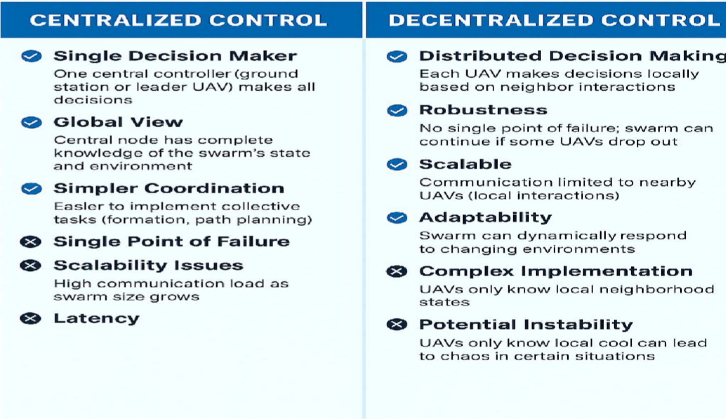
UAV Swarm Control

Slide 6
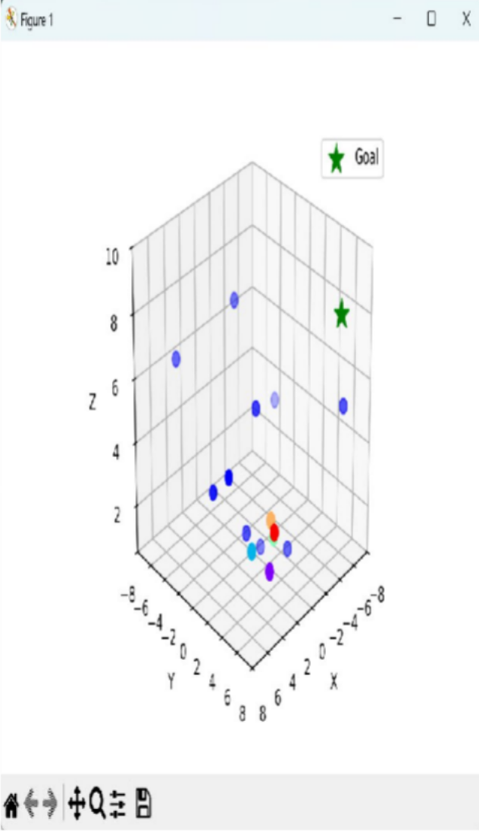
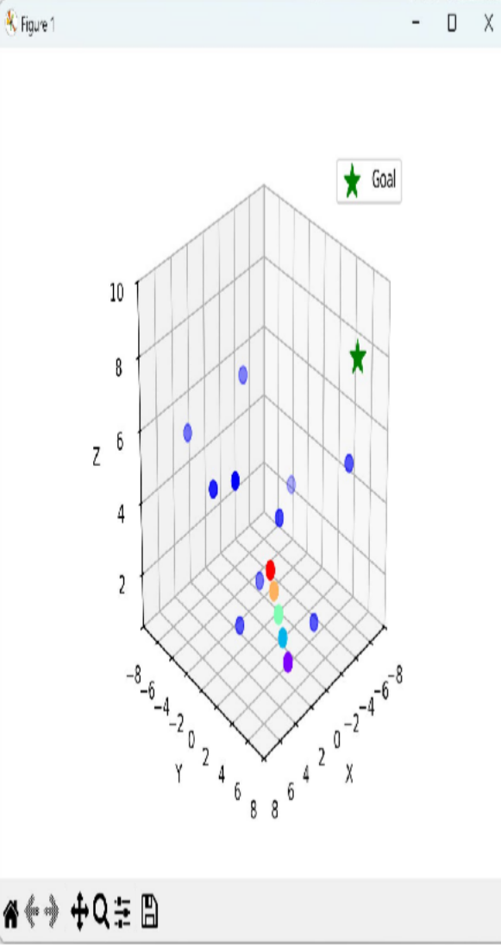
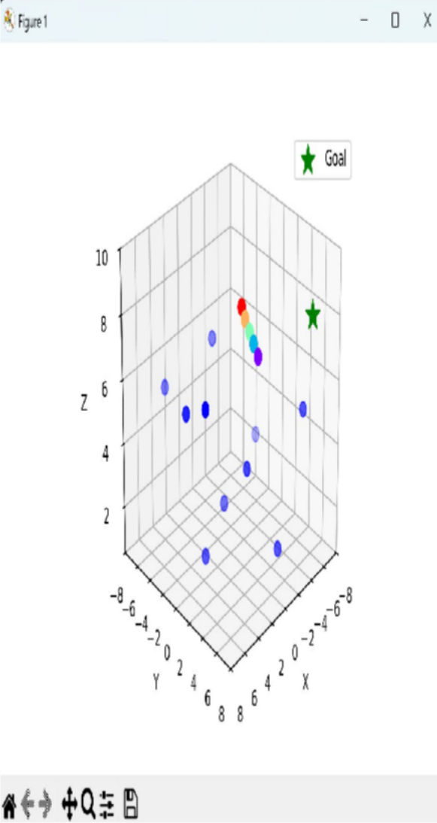
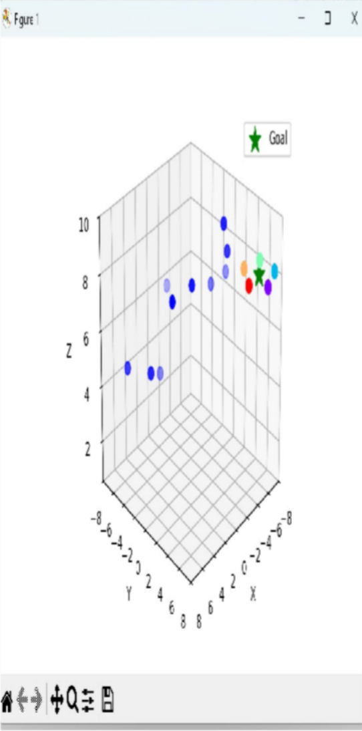
Work Done so Far - Centralized Control

Slide 7
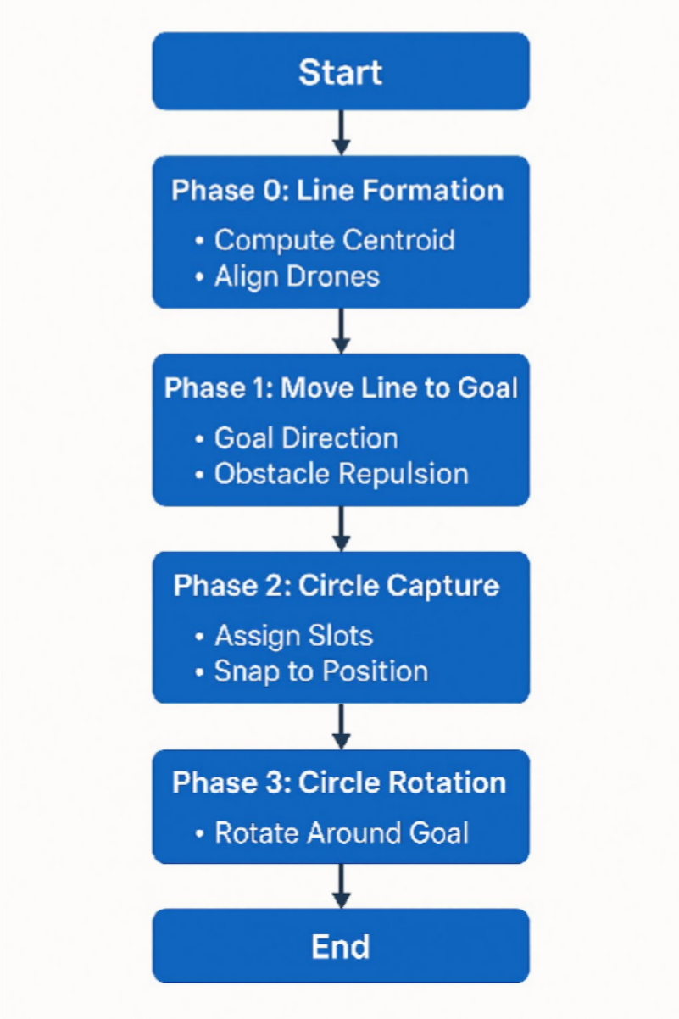
FLOWCHART

Slide 8
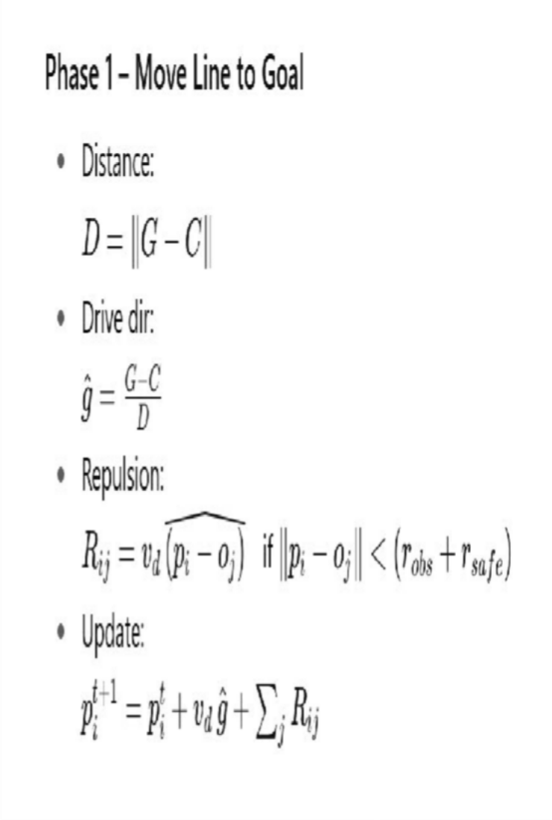
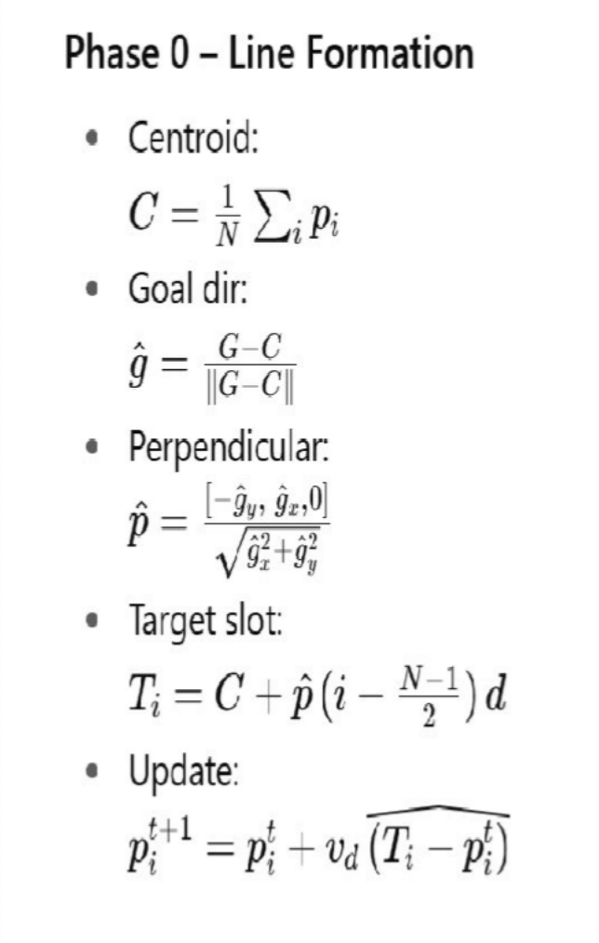
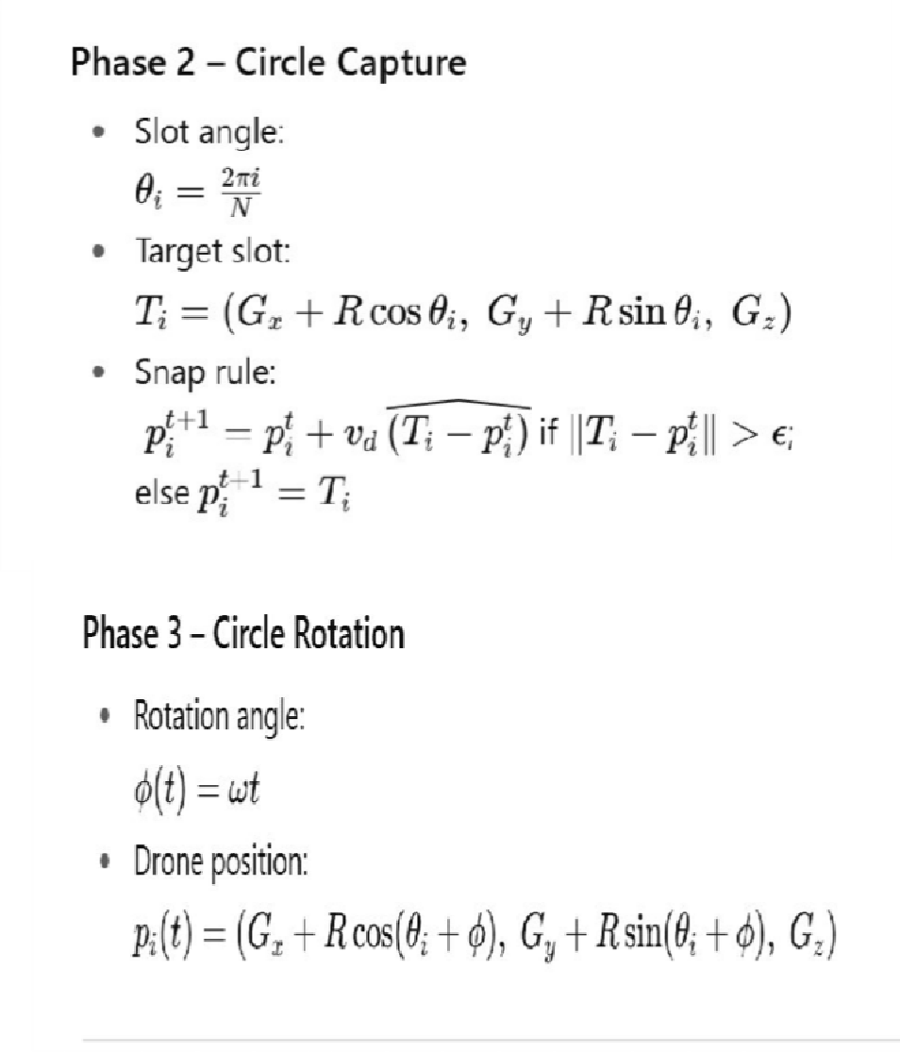
Phase-wise Equations - Centralized Control

Slide 9
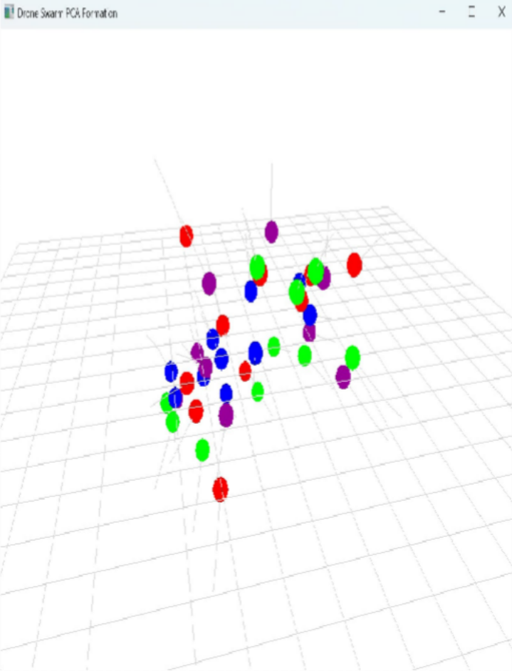
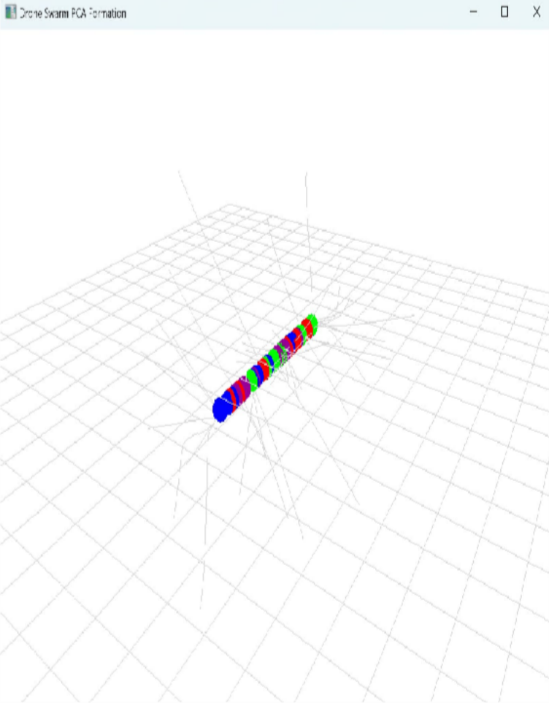
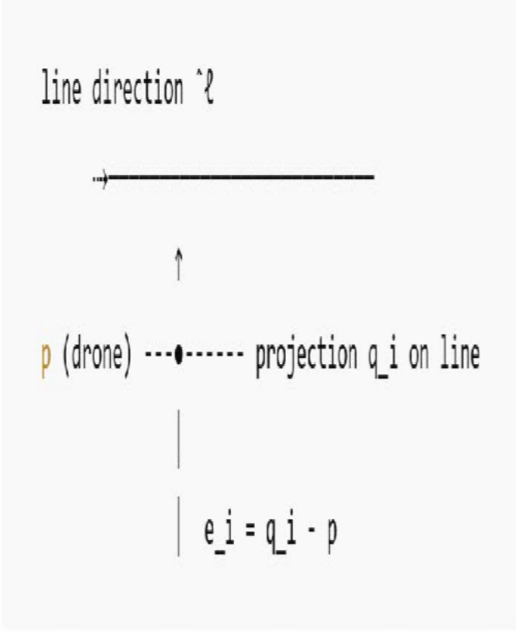
Work Done so Far - Straight line formation using Decentralized Control
Flow Chart

Slide 10
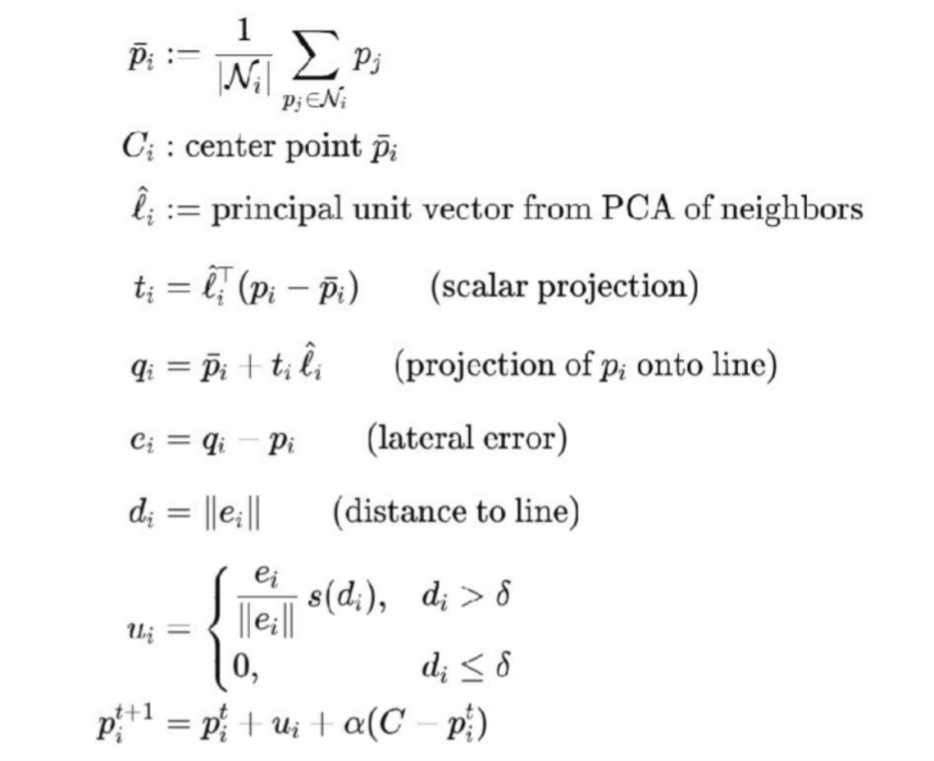
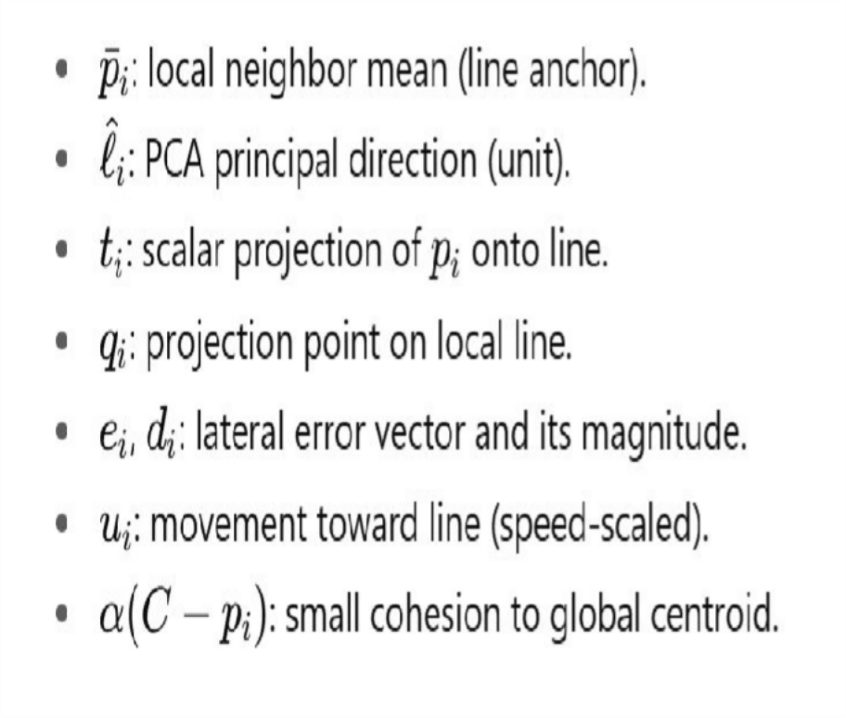
Equations used : Decentralized Control

Slide 11
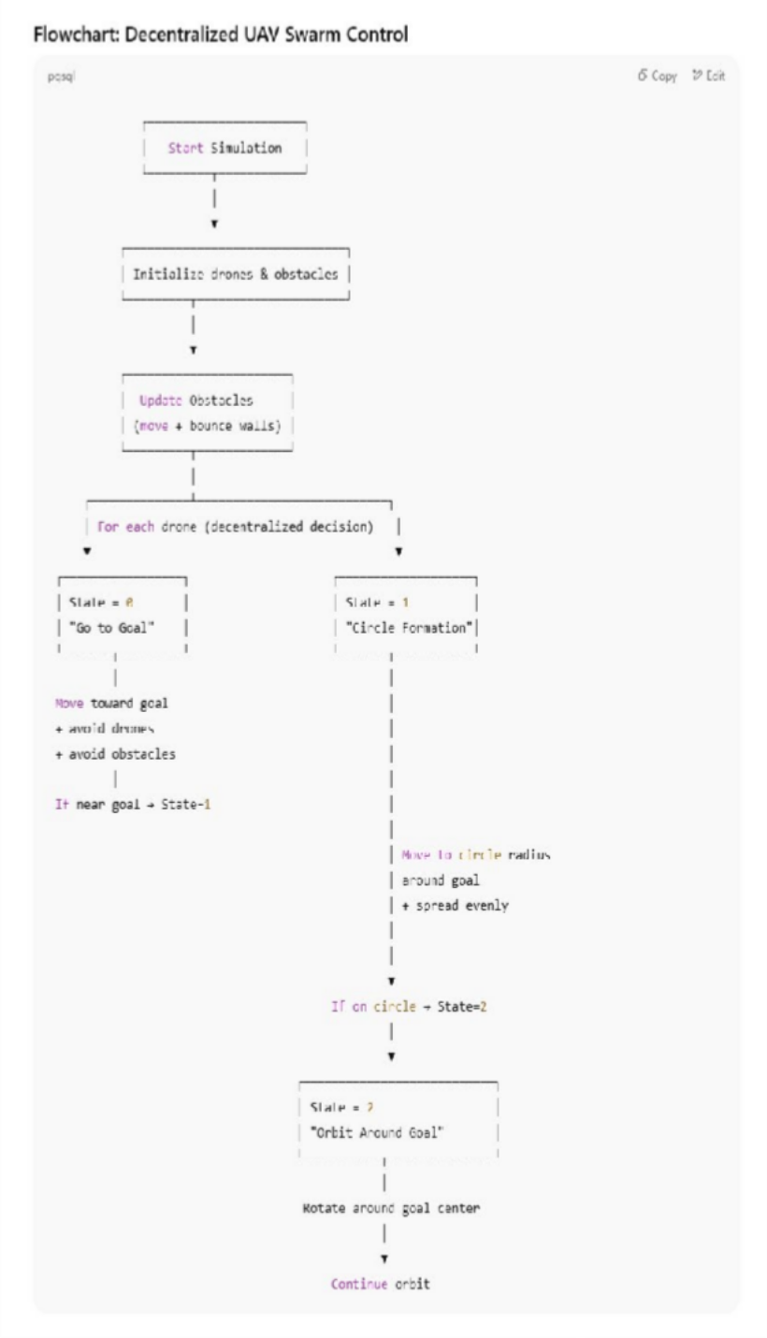
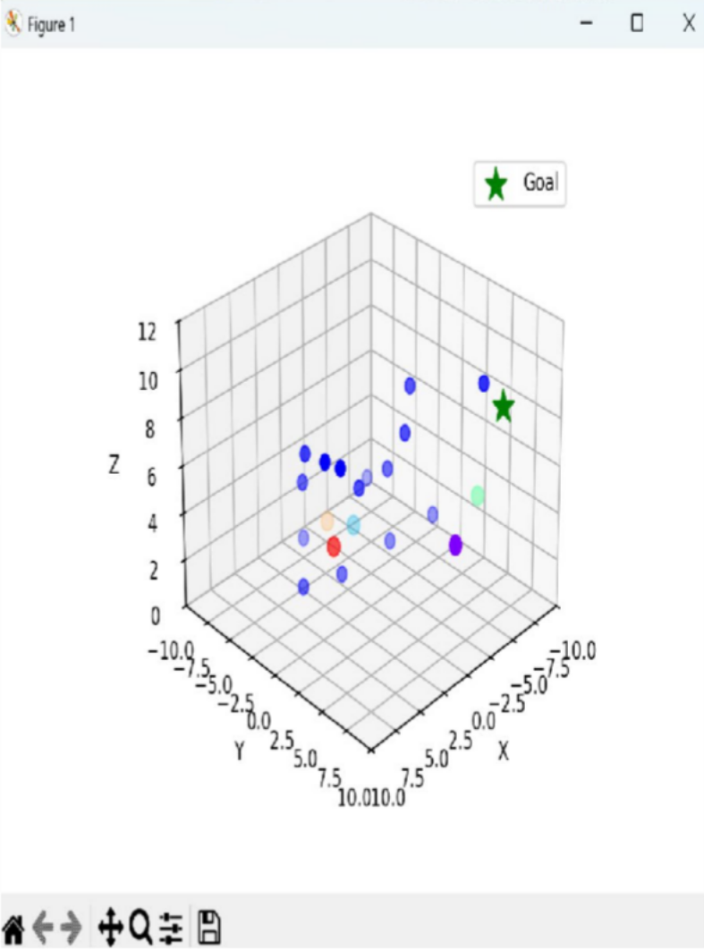
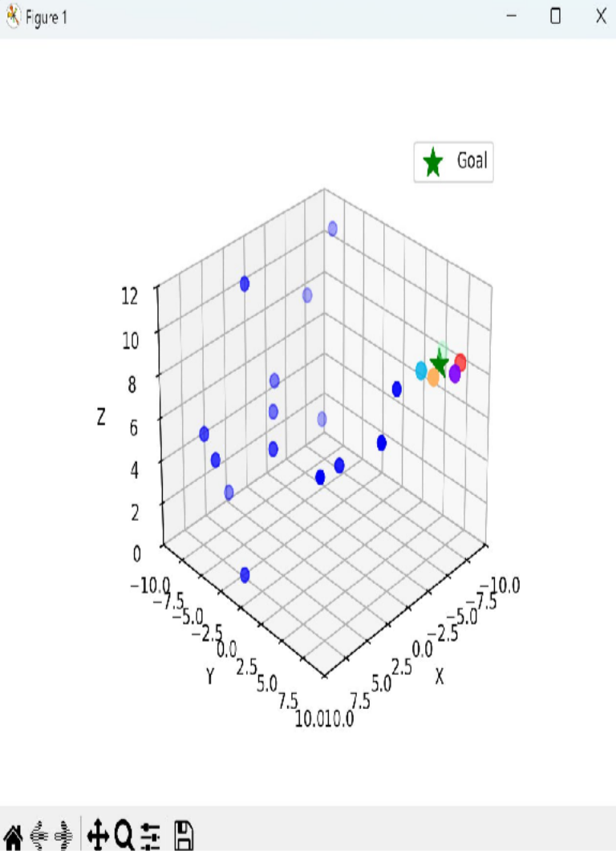
Work Done so Far - Circle form. & rotation, using Decentralized Control

Slide 12
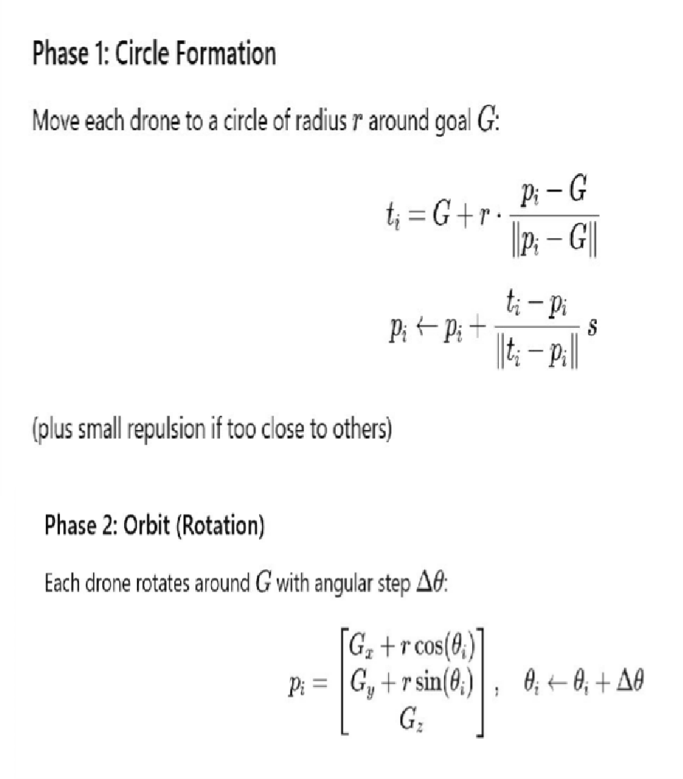
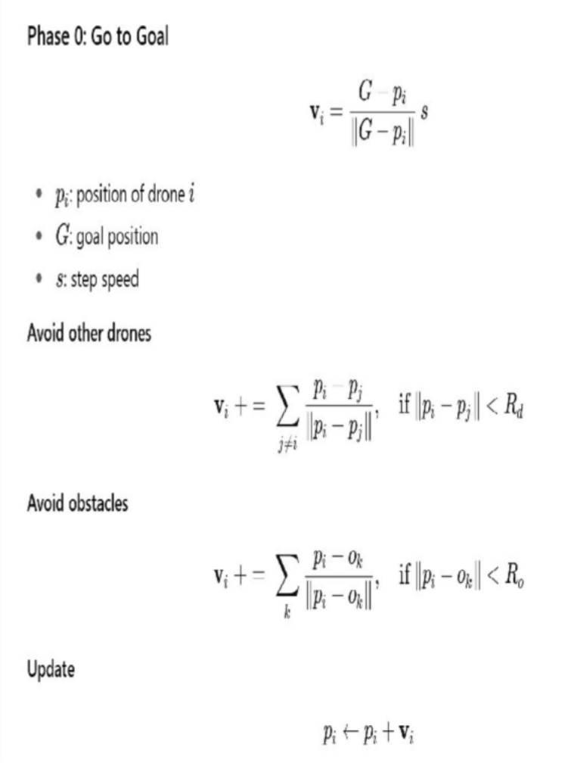
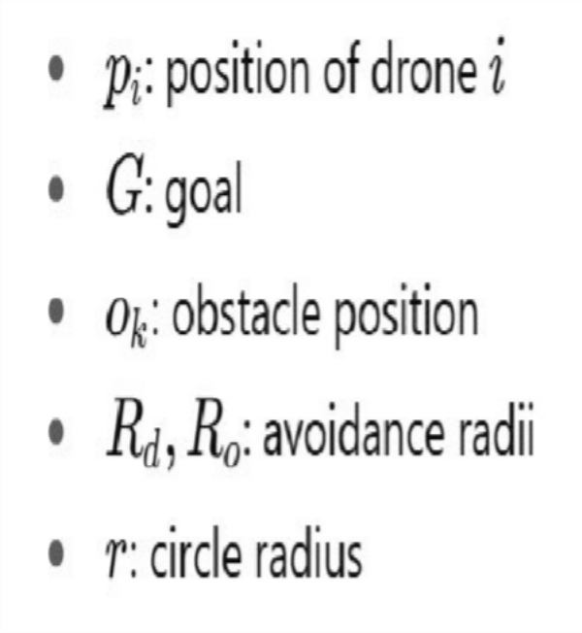
Equations used

Slide 13
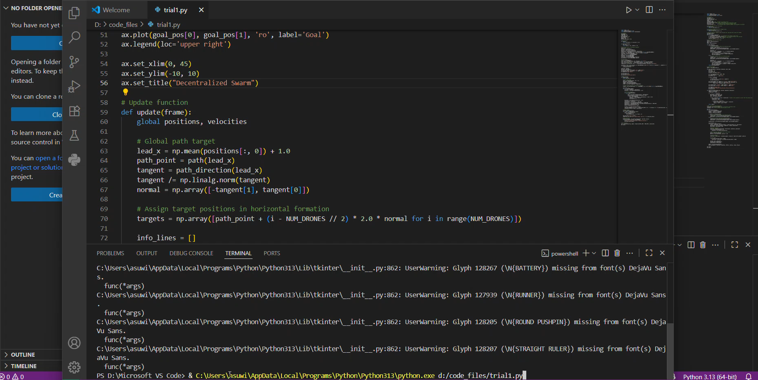
Horizontal Formation – Decentralized Approach

Slide 14
Future Work
Decentralized Control – Develop fully distributed decision-making without central authority.
Robustness – Ensure resilience against failures, noise, and dynamic environments.
Scalability – Extend framework to handle large-scale swarms with minimal computation.
iv. Autonomous Coordination – Enable self-organization for formation, path planning, and task allocation.
iii.

Slide 15
Applications
Search & Rescue Operations
Rapid area coverage
Victim localization in disaster zones
Environment Mapping
3D terrain and infrastructure mapping
Real-time data collection over large regions
Defence & Surveillance
Border monitoring and patrolling
Threat detection with persistent coverage

Slide 16
Thank You!

